Slide 1

Investigating Real-Time Communication Between Asymmetric Processors with OpenAMP
Barbato Emanuele
M63001822

Slide 2
Standard IPC in Heterogeneous AMP Systems
To facilitate Inter-Processor Communication (IPC) among heterogeneous processors on Asymmetric Multiprocessing (AMP) architectures, the industry traditionally relies on the standard OpenAMP framework using the RPMsg protocol over shared memory.
Classic OpenAMP Architecture

Slide 3
Beyond RPMsg: Hypervisorless VirtIO in AMP Architectures
Bypassing heavyweight hypervisor VM-exits, the hypervisorless VirtIO approach leverages a lightweight, user-space Physical Machine Monitor (PMM) on the Linux master core to expose standard virtual devices directly to Zephyr RTOS.
Hypervisorless VirtIO Architecture

Slide 4
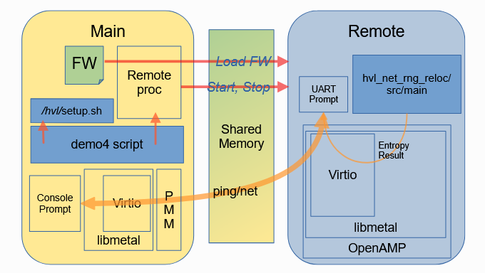
Reference Platform & Hardware Emulation
To ensure reproducibility, the Xilinx Zynq MPSoC (ZCU102) is emulated via QEMU within a containerized Docker environment.
On this platform, the OpenAMP demo4 framework drives an unmodified Zephyr guest running standard virtio-net and virtio-rng devices over a static physical shared memory bridge.
Emulated Environment Overview

Slide 5
Data Path Optimization: VirtQueues & Bounce Buffers
To enable hypervisorless communication, the architecture maps VirtIO-MMIO over static shared physical memory with symmetric Linux PMM and Zephyr RTOS access.
While the control path retains the standard three-VRing structure, the data path completely bypasses software translation traps by mapping Descriptor Ring pointers directly to pre-allocated, physically contiguous bounce buffers.
Shared Memory Zoom

Slide 6
From VM-Exits to Hardware IPIs
Since both operating systems execute natively on bare-metal, traditional hypervisor-mediated VirtIO doorbells (VM-exits) are physically impossible. To bridge this gap, the architecture maps signaling notifications to direct, physical Inter-Processor Interrupts (IPIs), completely bypassing software traps.
VM-Exits and IPIs Paradigms

Slide 7
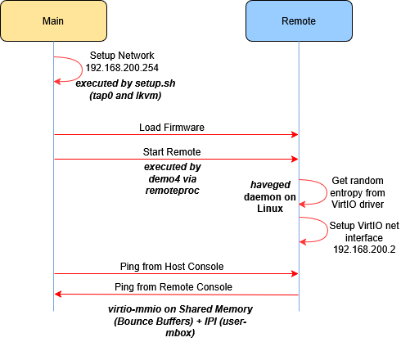
Execution Flow

Slide 8
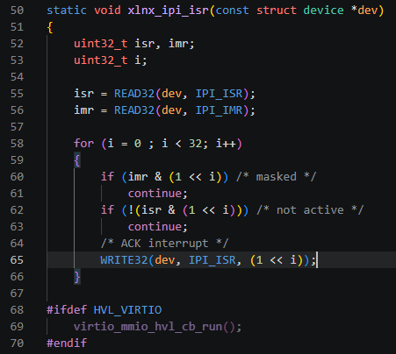
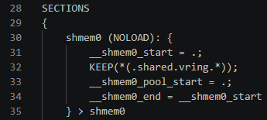
Mapping Theory to Code
Section of linker: allocation of the VRings
Static memory mapping: Standard dynamic allocation is bypassed; VirtQueues are forcefully allocated at the shared physical address 0x37000000 via directives in the custom linker script, as well as bounce buffers.
Direct hardware signaling: The absence of traditional software traps (VM-exits) is compensated by physical Inter-Processor Interrupts (IPIs), triggered via a direct memory write to the IPI_TRIG hardware register
Section of xlnx_ipi.c showing the catching ISR

Slide 9
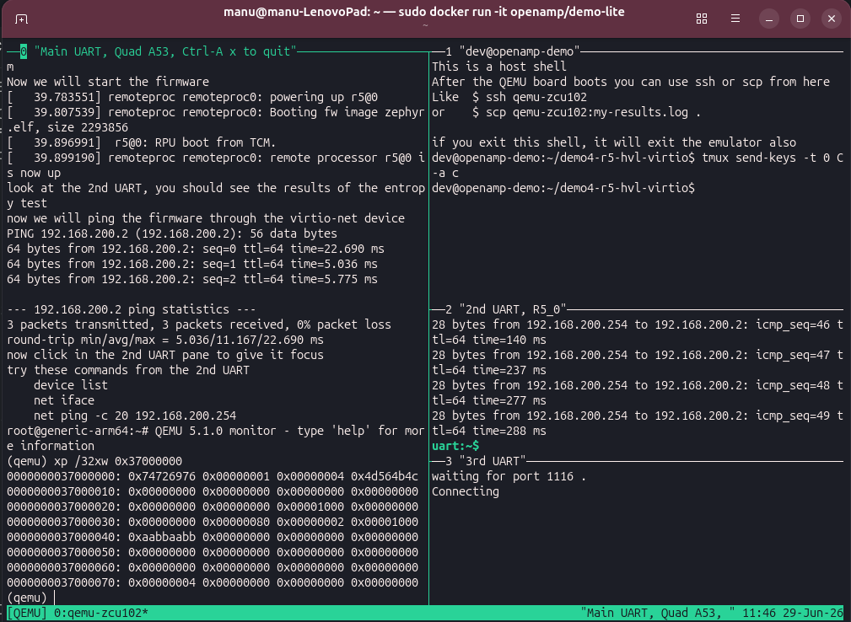
Static Memory Inspection
0x74726976: "v i r t" magic string in ASCII
0x00000001: VirtIO device version (Version 1).
0x00000004: Device ID. According to the VirtIO specification, ID 4 corresponds exactly to the Virt-RNG (entropy) device.
0x4d564b4c: In ASCII, this translates to "L K V M", the Vendor ID. This provides irrefutable proof that the device was created by the user-space lkvm PMM.
0xaabbaabb: Value that matches the macro defined in Zephyr's driver, for a custom acknowledgement of the hypervisorless paradigm
Memory dump at shared memory base address

Slide 10
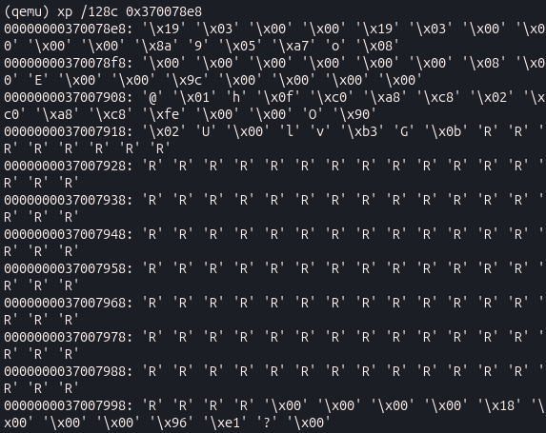
Dynamic Payload Interception
ping -p 52 -s 128 -c 500 192.168.200.2
Hexadecimal value corresponding to letter “R” in ASCII
The cost of isolation: The Zephyr driver uses its private SRAM, which is inaccessible to Linux; the transport therefore mandates an explicit copy (memcpy) of the packet into the intermediate Bounce Buffers.
Dynamic verification: By suspending QEMU and scanning the Descriptor Ring, the physical pointer to the Bounce Buffer was located, visually proving the transit of the custom payload within the shared memory
Custom payload found in bounce buffer

Slide 11
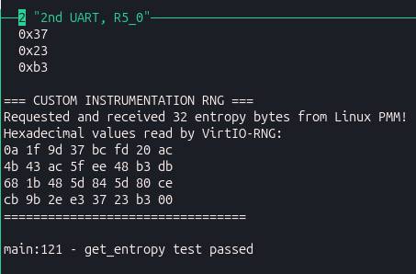
Custom Firmware Instrumentation
Custom cross-compilation: Generated the zephyr.elf personalized firmware, forcing the compiler to exclusively link the experimental hypervisorless frontend modules to resolve dependency conflicts.
Frontend alteration: The silent boot behavior of the virt-rng driver on Zephyr was modified to explicitly request and print a larger payload (32 bytes of entropy).
Zephyr print after custom instrumentation

Slide 12
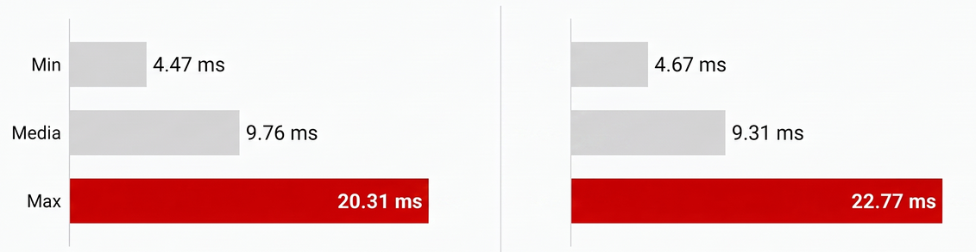
Latency Analysis in Zync UltraScale+ with QEMU
Ping 56 byte: Standard Latency
Ping 1400 byte: Larger Payload
~2.4 ms jump in maximum latency which proves the architectural trade-off: lacking RPMsg's true zero-copy, the processor is forced to spend extra clock cycles explicitly copying the larger payload into the shared bounce buffers (explicit memcpy).

Slide 13
Contextualizing Time and Emulation Limits
It is mandatory to state that the timing measurements obtained in this experiment are not representative of absolute real-time hardware performance.
As the execution environment relies entirely on QEMU, the recorded ping latencies are heavily distorted by the host OS scheduler, background processes, and the virtualization overhead of the Docker container.
Therefore, the results successfully demonstrate the functional behavior and the relative trends of the hypervisorless VirtIO architecture, but they cannot be used to assess adherence to industrial real-time deadlines.

Slide 14
Real-Time Relevance: Where It Wins, Where It Waits
Massive Software Reuse: By elevating VirtIO directly over shared memory, the Zephyr RTOS interacts with the Linux backend as if it were interacting with physical hardware. Standard VirtIO drivers can be used without writing custom, proprietary RPC protocols from scratch.
True Bare-Metal Determinism: Removing the heavyweight hypervisor eliminates VM-exits and hypervisor scheduling overhead. The Cortex-R5 core runs natively on bare-metal, achieving desired determinism for its local tasks
Direct Hardware Signaling: Uses physical Inter-Processor Interrupts (IPIs) for direct core-to-core signaling.
Security Vulnerabilities: The PMM operates in Linux user-space with direct access to the pre-shared memory pool. Without strict hardware separation, a compromised "rich OS" could expose the RTOS memory to external vulnerabilities
Explicit Memory Copies: The lack of shared-memory awareness in standard frontend drivers mandates an explicit memcpy into the shared bounce buffers, limiting throughput.
Inherited Jitter on the Communication Path: While the RTOS is deterministic, the inter-processor data exchange is not. Waking up the Linux PMM relies on the Linux OS scheduler (kernel module) introducing latency and the typical jitter of general-purpose operating systems.

Slide 15
Questions & Answers
Thank you for your Attention

